Slide 1
Lecture 5 Timing
Tian Sheuan Chang

Slide 2
Outlines
Timing definition
How to read a timing report

Slide 3
Some defintions

Slide 4
Edge-Triggered D Flip Flop
Setup time
Hold time
Setup time: inputs become stable before rising clock;
Hold time: inputs remain stable after rising clock;
Notes:
輸入在activate clock edge 前後不能變動的時間

Slide 5
How Fast My Design Can Run?
Up to 100MHz? 200MHz?
Slower at 10KHz, 20KHz? Any speed?

Slide 6
How Fast My Design Can Run?
Fastest clock cycle time: T_{c}
Notes:
What we care
系統最快可以跑多快?T_{c}
組合邏輯可以有的最長計算時間, T_{pd}

Slide 7
Max Delay
T_{c} >= t_{pcq} + t_{pd} + t_{setup}
t_{pd} <=T_{c} – (t_{pcq} + t_{setup} )
Register overhead
If delay of comb. Logic is too long)
Setup time violation
DFF will catch the wrong value
1. clock run slower
T_{c} become larger
2. comb. Logic faster
T_{pd} smaller by pipeline or algorithm change
Notes:
Example
10 1 10 1

Slide 8
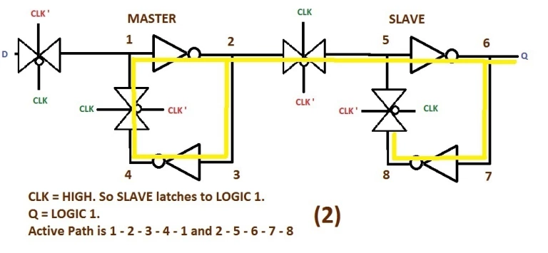
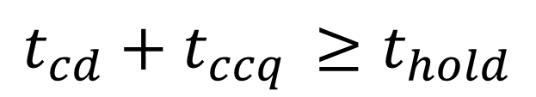
Min-Delay: Flip-Flops
$$t_{cd}+t_{ccq }≥t_{hold}$$
If not hold,
(comb. Logic delay is too short)
hold time violation
DFF will catch the wrong value
1. Decreasing clock rate does not work
2. Increase tcd (e.g. add delay, buffer)
Notes:
如果不等式不成立，
(comb. Logic 的delay太短)
hold time violation
DFF值會不對
怎麼降clock速度都沒用
增加tcd (e.g. 加delay, buffer)
20141117 DIC
For example, a pipeline can use back-to-back registers
to sequence along an instruction opcode without modifying it. However, if the hold
time is large and the contamination delay is small, data can incorrectly propagate through
two successive elements on one clock edge, corrupting the state of the system. This is
called a race condition, hold-time failure, or min-delay failure. It can only be fixed by redesigning
the logic, not by slowing the clock. Therefore, designers should be very conservative
in avoiding such failures because modifying and refabricating a chip is catastrophically
expensive and time-consuming.

Slide 9
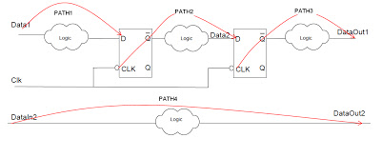
Timing Paths
Input to register, register to register, register to output
Start from or end to DFFs
Input to output
Input to register
register to register
register to output
3
5
2
Input to output
7
http://www.vlsi-expert.com/2011/03/static-timing-analysis-sta-basic-timing.html
Notes:
http://www.vlsi-expert.com/2011/03/static-timing-analysis-sta-basic-timing.html

Slide 10
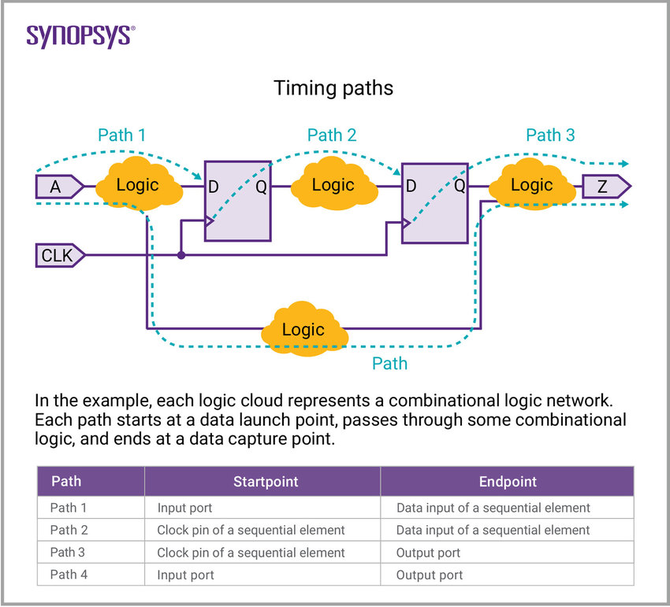

Slide 11
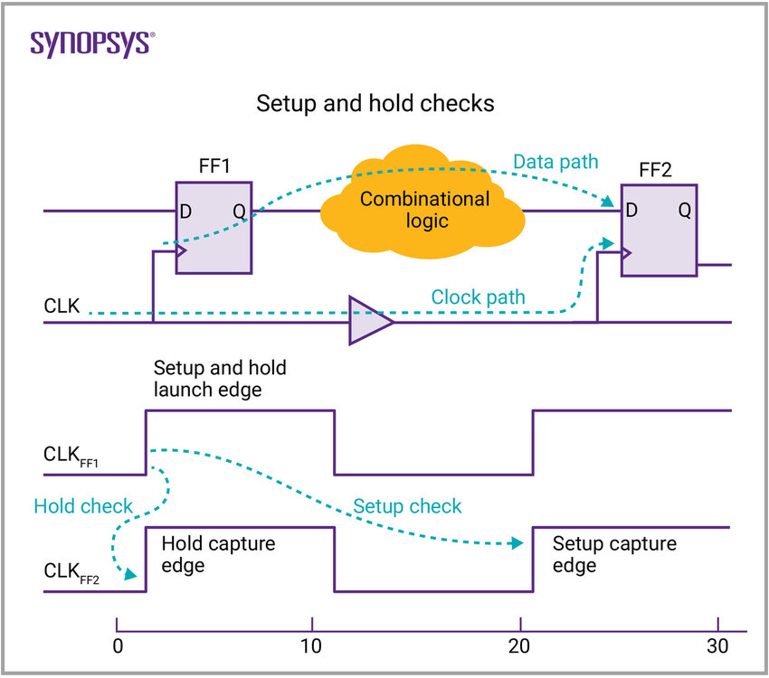

Slide 12
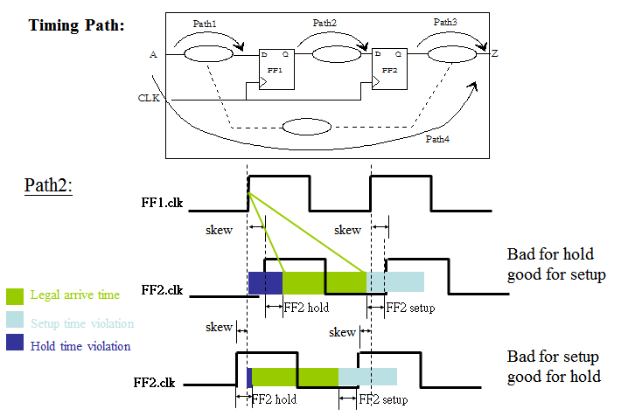
https://sites.google.com/site/kennethnote/technology-detail/sta-timing

Slide 13


Example
t_{dCQ} = t_{cCQ} = t_{s} = 150ps
t_{h} = 250ps
t_{dMax} = 850ps
t_{cMin} = 100ps
Is hold time constraint met?
250ps <= 100+ 150ps
What is the minimum cycle time?
t_{cy} >= 1150ps
$$≤$$
$$≥$$
Notes:
250<=150+100 met
Minimum cycle time 150+850+150 = 1150

Slide 14
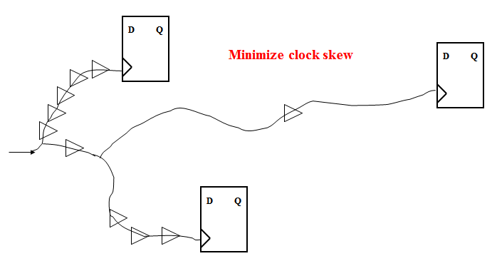

Slide 15
Add Clock Skew t_{k}
Cycle get larger
Hold time tighter
Skew always reduces slack (margin)
Clock skew: arrival time of clock signal difference
check timing path as in timing report
Notes:
Skew + => 後面DFF 的clock 到達時間比較晚

Slide 16
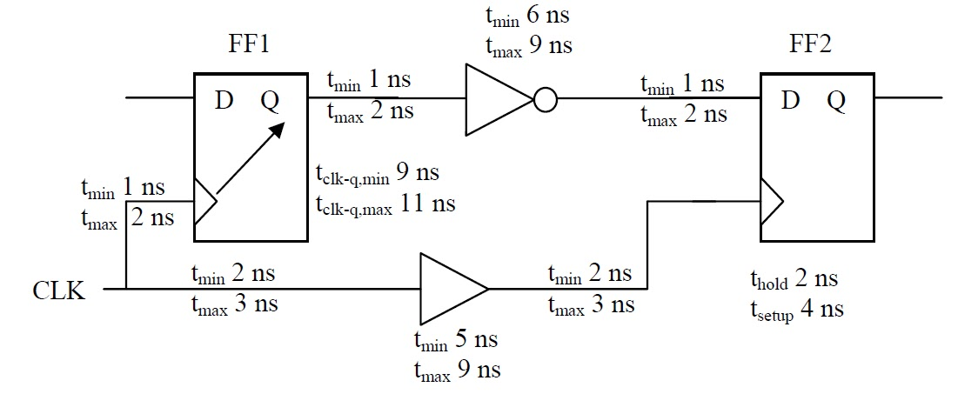
Setup time check
Maximum Delay along the data path.
Minimum Delay along the clock path.
Delay in Data path
= max(wire delay to the clock input of FF1) + max(Clk-to-Q delay of FF1) +max(cell delay of inverter) + max(2 wire delay- "Qof FF1-to-inverter"and "inverter-to-D of FF2")
=Td = 2+11+9+(2+2) = 26ns
Clock path Delay
= (Clock period) + min(wire delay from CLK to Buffer input) + min(cell delay of Buffer) + min(wire delay from Buffer output to FF2/CLK pin) -(Setup time of FF2)
=Tclk = 15+2+5+2-4=20ns
If Clock period is 22ns then
Tclk = 22+2+5+2-4=31-4=27ns AND Td = 26ns
Setup Slack = Tclk - Td = 27-26=1ns (No Violation)
Setup Slack = Tclk - Td = 20ns - 26ns = -6ns.
Since Setup Slack is negative -> Setup violation.
Notes:
http://www.vlsi-expert.com/2011/05/example-of-setup-and-hold-time-static.html

Slide 17
Hold Analysis
Minimum Delay along the data path.
Maximum Delay along the clock path.
Delay in Data path
= min(wire delay to the clock input of FF1) + min(Clk-to-Q delay of FF1) +min(cell delay of inverter) + min(2 wire delay- "Qof FF1-to-inverter" and"inverter-to-D of FF2")
=Td = 1+9+6+(1+1)=18ns
Clock path Delay
= max(wire delay from CLK to Buffer input) + max(cell delay of Buffer) + max(wire delay from Buffer output to FF2/CLK pin) + (hold time of FF2)
=Tclk = 3+9+3+2 = 17 ns
Note:
If the hold time had been 4 ns instead of 2 ns, then there would have been a hold violation.
Td=18ns and Tclk = 3+9+3+4=19ns
So Hold Slack=Td - Tclk = 18ns - 19ns = -1ns (Violation)
Hold Slack = Td - Tclk = 18ns -17ns = 1ns
Since Hold Slack is positive-> No hold Violation.

Slide 18
Summary
Delays in digital systems
Propagation delay
Contamination delay
Flip-flop timing constraints
Setup time (t_{s})
Hold time (t_{h})
Cycle time determined by maximum delay
Correct operation depends on minimum delay
Clock skew affects both

Slide 19
How to read your timing report

Slide 20
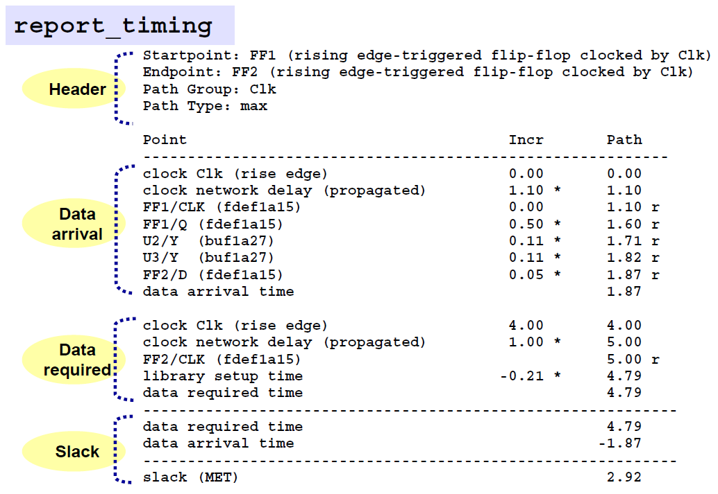
How to Read and Interpret Timing Report

Slide 21
Constraint File (note. These numbers may not match the following slides)
//設定clock, I/O 限制
create_clock "clk" -name clk -period 2 -waveform {0 1.7}
set_clock_uncertainty 0.2 clk
set_fix_hold all_clocks()
set_input_delay 0.5 -clock clk {in}
set_output_delay -max 0.8 -clock clk {isprime}
//設定 loading
set_load -pin_load 5 {isprime}
//Note: these commands are for practical applications to include
// clock jitter, input/output loading capacitances

Slide 22
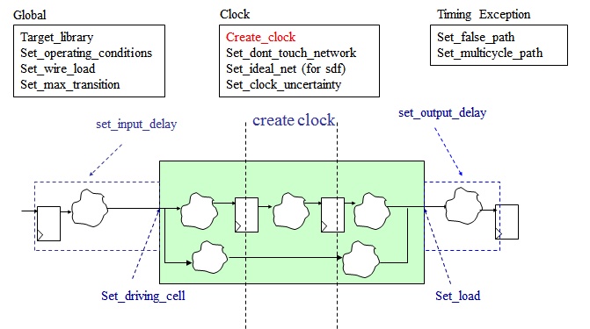
(Optional)

Slide 23
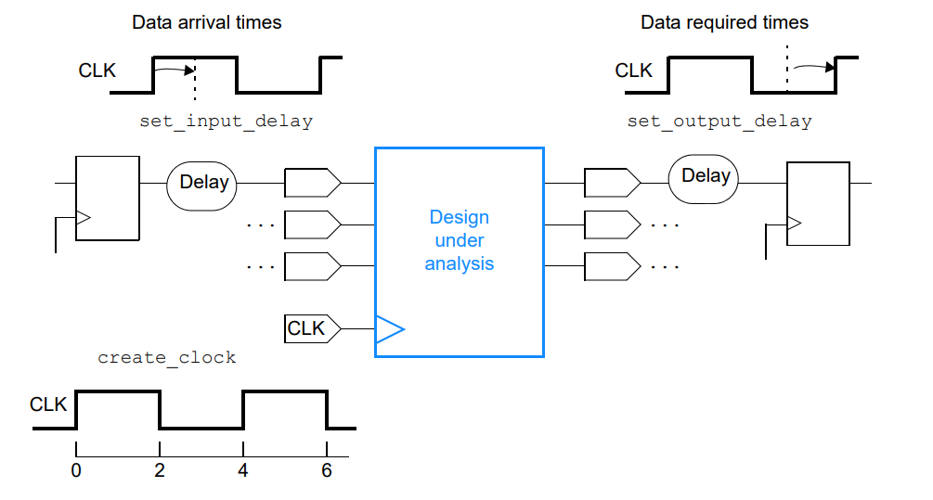
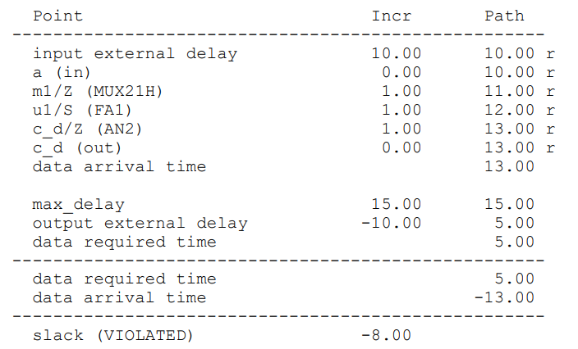

Slide 24
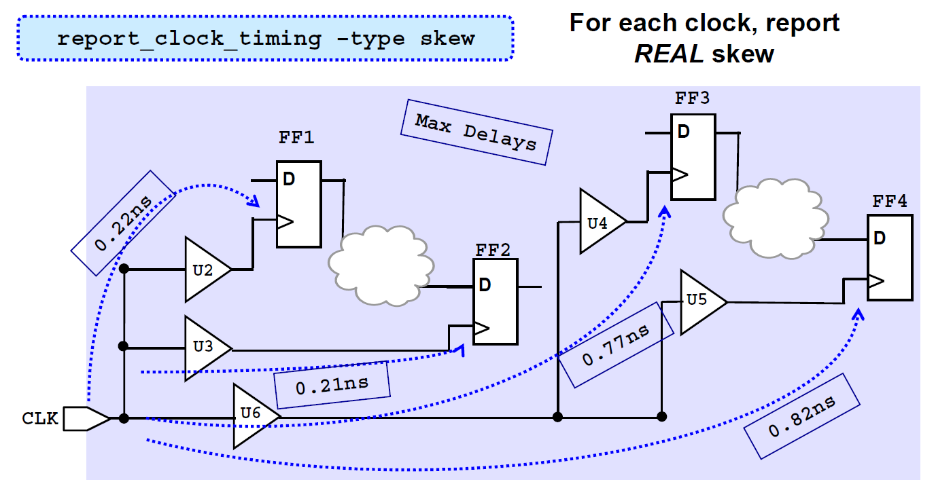
Clock Network and Clock Skew

Slide 25
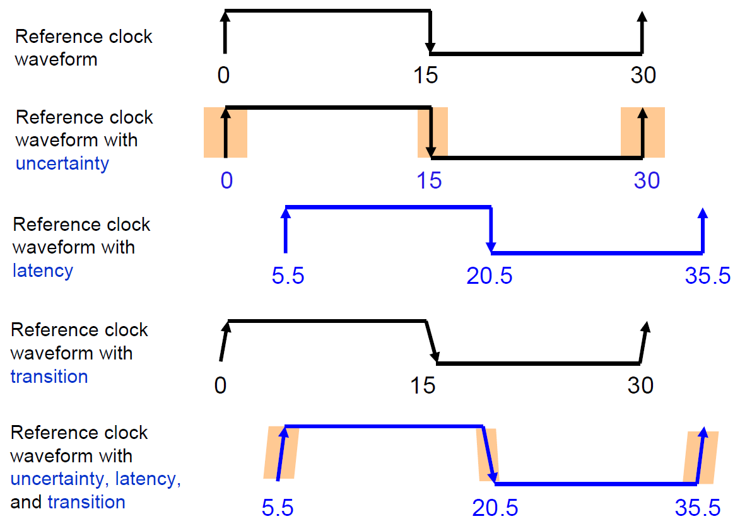
Specify Timing Assertions (Optional)

Slide 26
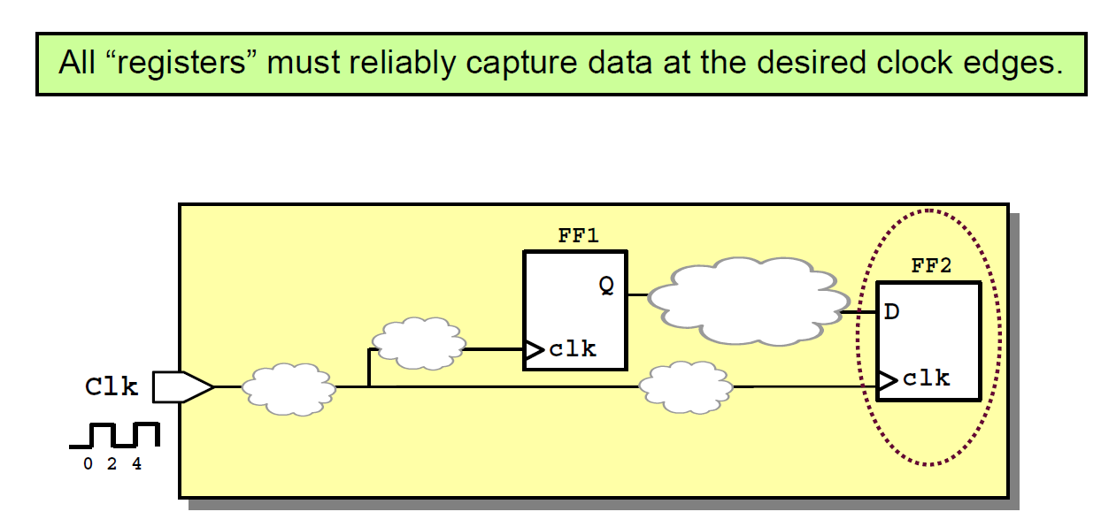
Timing Verification of Synchronous Designs

Slide 27
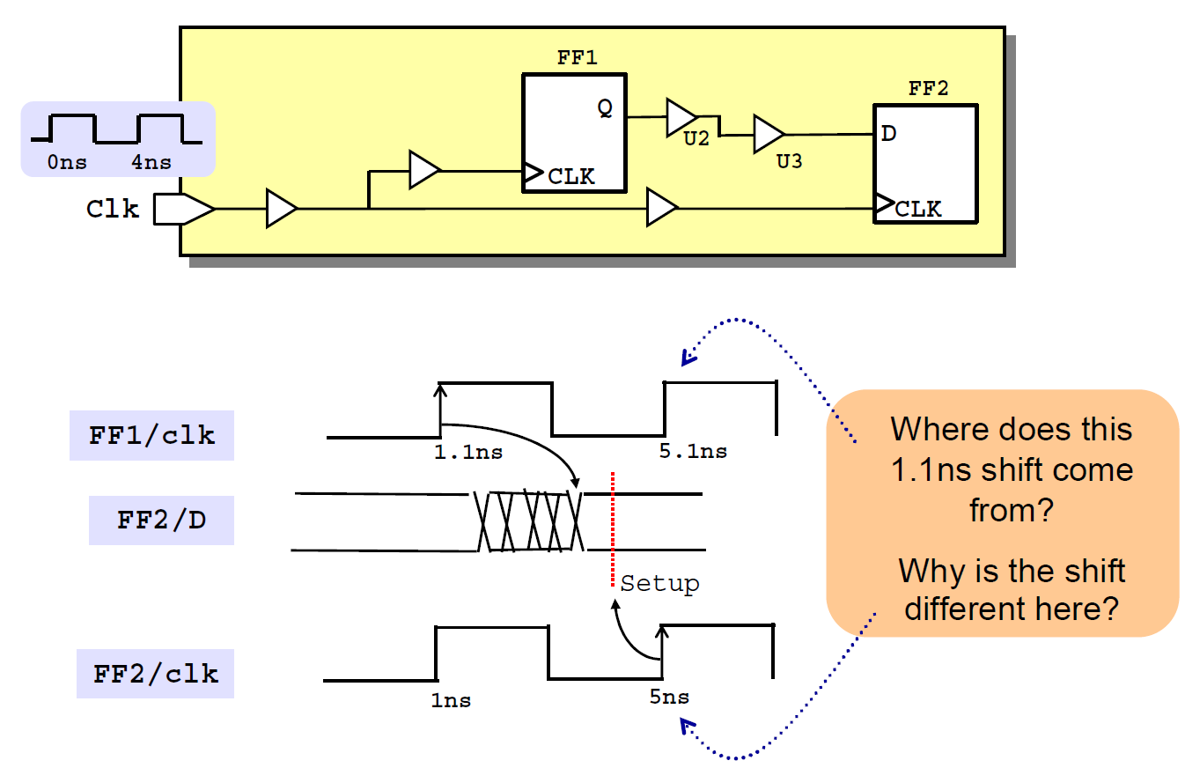
Clock skew
Notes:
Static Timing Verification of FF2: Setup

Slide 28
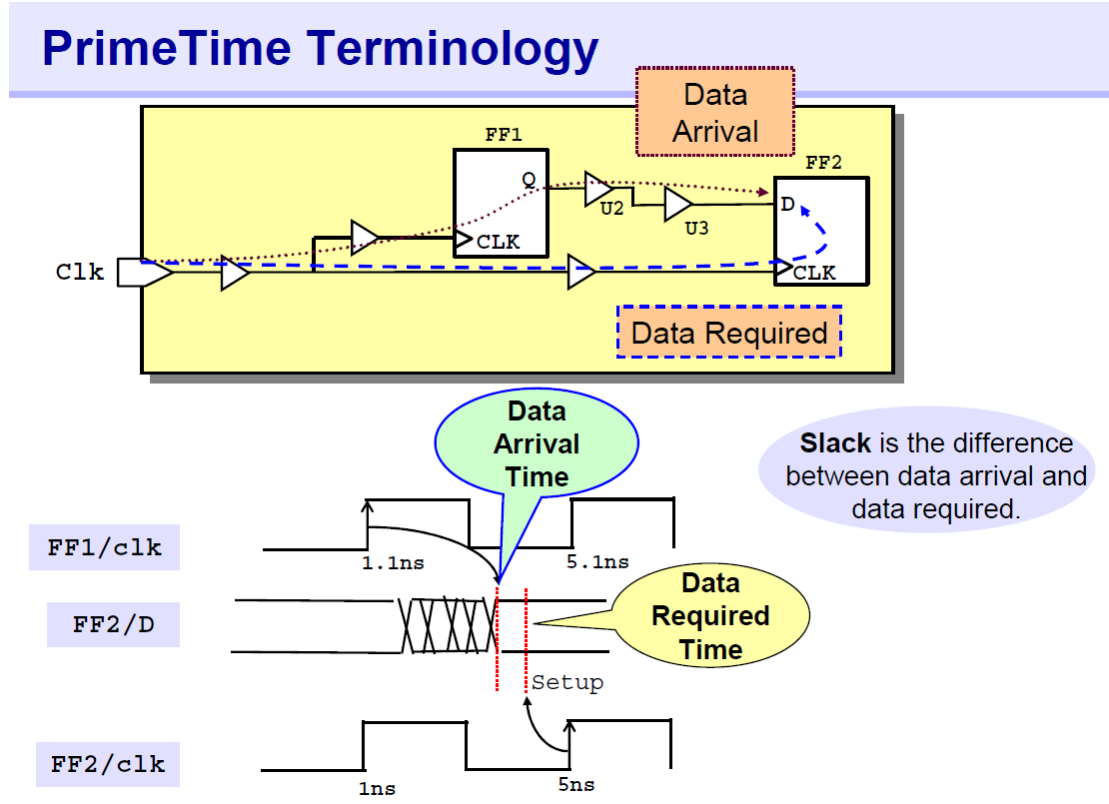

Slide 29
Four Sections in a Timing Report

Slide 30
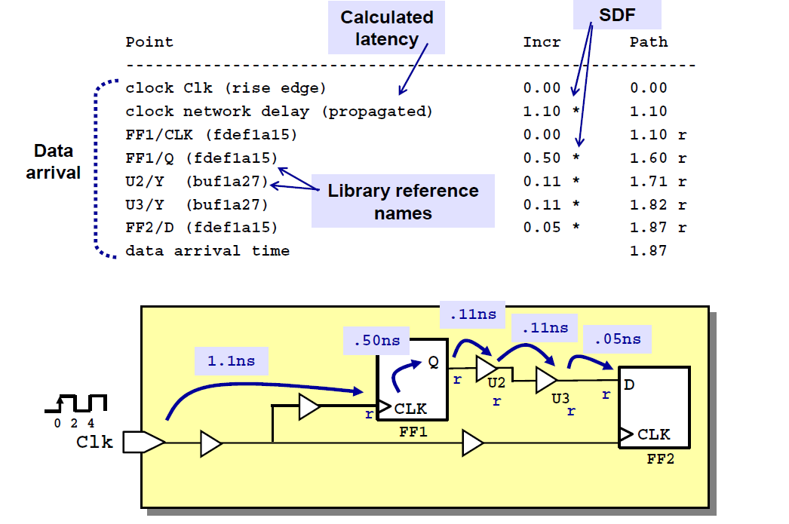
Data Arrival Section

Slide 31
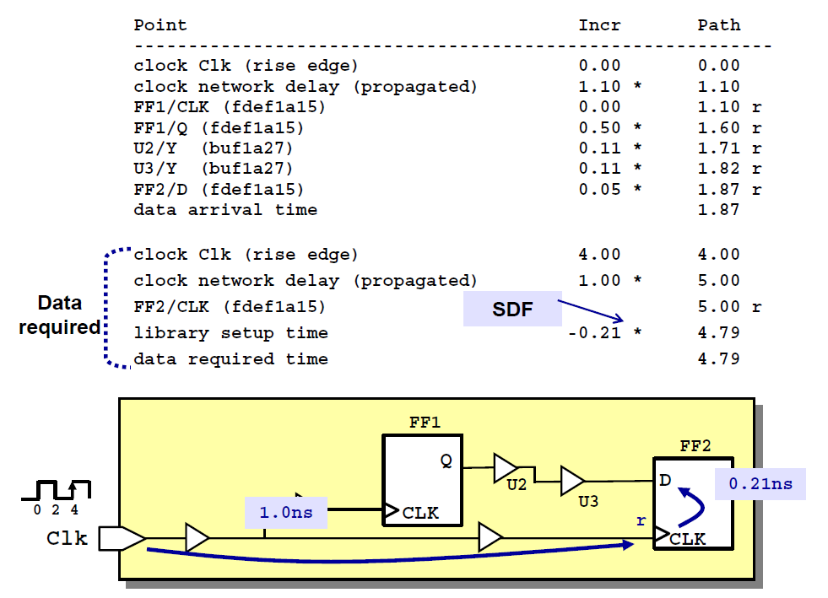
Data Required Section

Slide 32
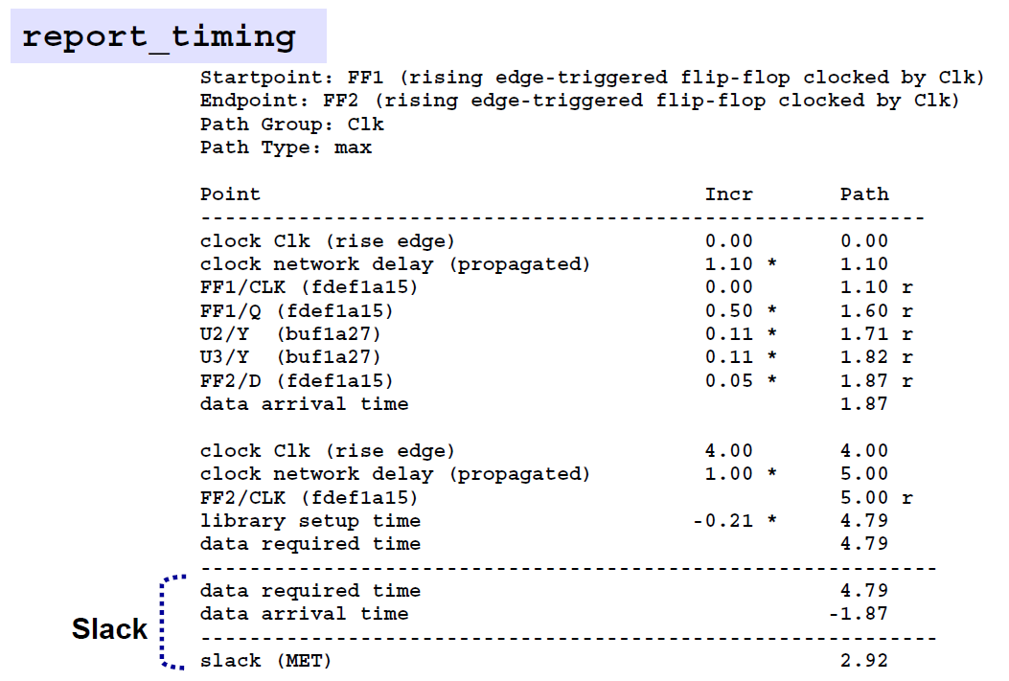
Summary - Slack

